Slide 1
Object Oriented Programming(Java) Lecture 12

Slide 2
Content
Java Package.
Built-in Package.
User-defined Package.
How to import packages in Java?
Example: Package and importing package.

Slide 3
Java Package :
A package is simply a container that groups related types (Java classes, interfaces, enumerations and annotations).
For example, in core Java, the ResultSet interface belongs to java.sql package.
The package contains all the related types that are needed for SQL query and database connection.

Slide 4
Java Package :
Based on whether the package is defined by the user or not, packages are divided in two categories:
Built-in Package
User-defined Package
.

Slide 5
Built-in Package :
Built-in packages are existing java packages that come along with the JDK.
For example :
java.lang, java.util, java.io etc.

Slide 6
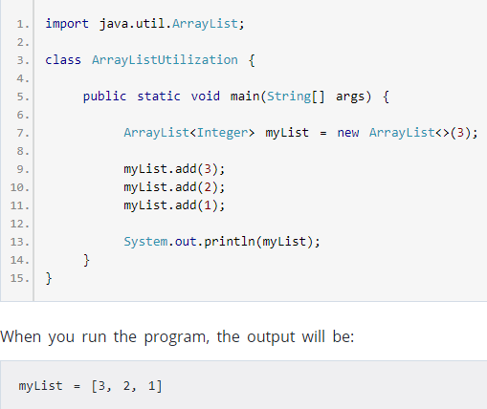
Built-in Package :

Slide 7
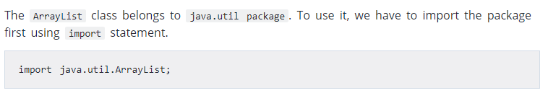
Built-in Package :

Slide 8
User-defined Package :
Java also allows you to create packages as per your need. These packages are called user defined packages.
To define a package in Java, you use keyword package.
package packageName;

Slide 9
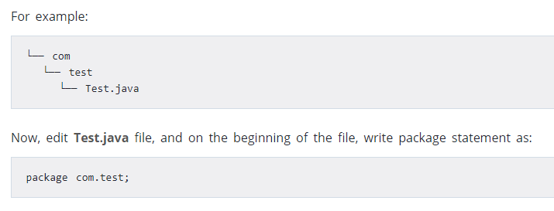
User-defined Package :
Java use file system directories to store packages. Let’s create a Java file inside another directory.
For example:

Slide 10
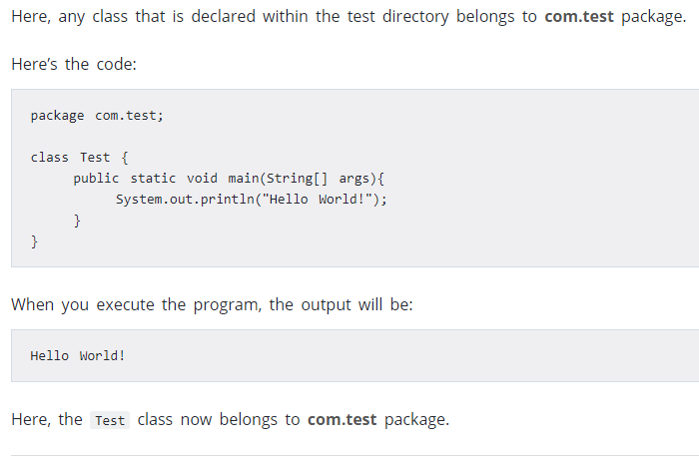
User-defined Package :

Slide 11
How to create a package in Netbeans IDEA?
In Netbeans IDEA, here’s how you can create a package:
Right click on the source folder.
Go to new and then package.

Slide 12
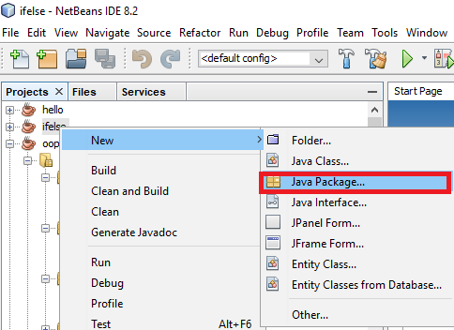
How to create a package in Netbeans IDEA?

Slide 13
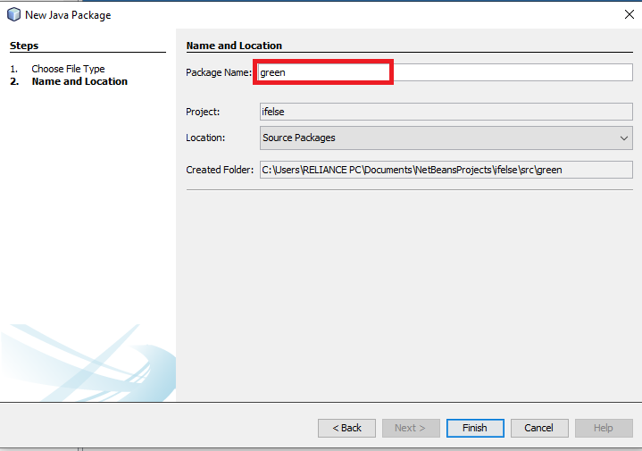
How to create a package in Netbeans IDEA?

Slide 14
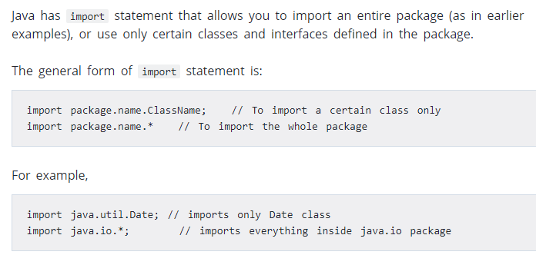
How to import packages in Java?

Slide 15
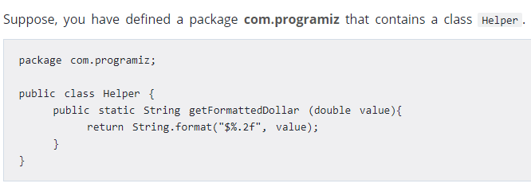
Example: Package and importing package

Slide 16
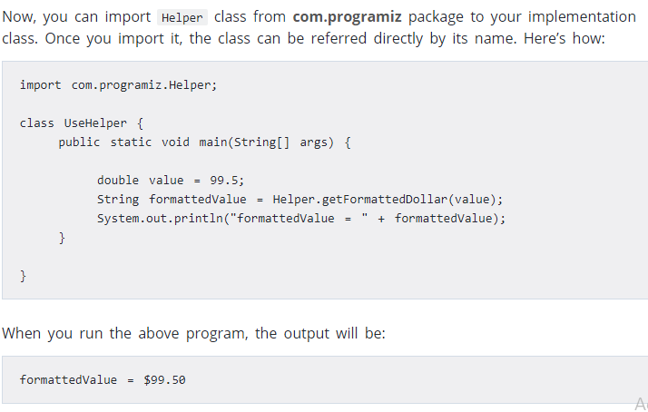
Example: Package and importing package

Slide 17
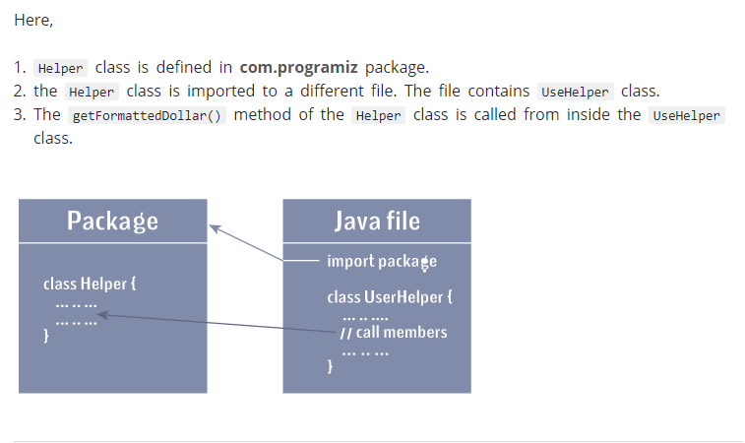
Example: Package and importing package

Slide 18
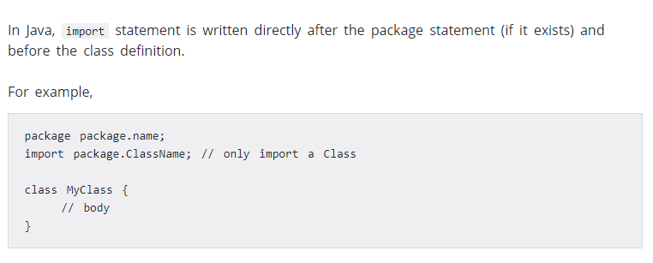
Example: Package and importing package

Slide 19
References :
https://www.programiz.com/java-programming/packages-import#example.

Slide 20
Thanks

